Slide 1
Civil Design Considerations for ITS Implementations
February 22, 2017

Slide 2
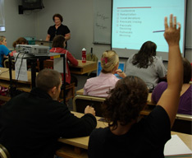

Case Study Format and Purpose
Case Study Purpose
Provide overview of civil design considerations related to Intelligent Transportation Systems (ITS)
Explore approaches to integrating ITS components into field settings
Components
1: Presentation
2: Take Home Exercise
3: Debrief
Notes:
Purpose of Slide: Introduce purpose of the case study.
Key Message: This case study provides an overview of civil design supporting ITS.
Time on Chart: 1 minute
Suggested Comments: This case study will introduce you to civil design considerations and issues in support of Intelligent Transportation Systems (ITS) deployments. The support includes existing infrastructure, structures, utilities, communication, and security. The Case Study assumes an understanding of ITS concepts. There are 3 components to this case study. This presentation will provide the background and discussion for introduction to ITS infrastructure and consider some of the alternatives for implementation. You will be given a take home exercise to further expand your learning experience. You will report your findings during a debriefing to close this case study.
Transition:
Interactivity:
Additional Resources:

Slide 3
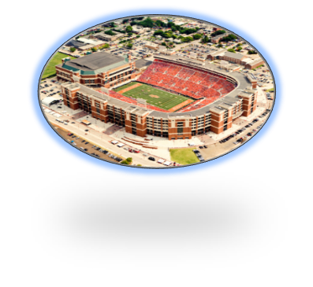
Exercise Preview
Topic
Develop Camera Location Design for Case Study
Scenario
University Football Stadium traffic congestion
Planned events
Growing attendance/traffic
Stadium expansion
City transportation system cannot accommodate demand
Functional ITS Architecture previously developed
Student Role
ITS Design Engineer
Resources
Sample plan sheets
Notes:
Purpose of Slide: Provide students a preview of the exercise so they know what they will be doing and can relate the lecture to their task.
Key Message: In the exercise, students will define an implementation plan for this Case Study.
Time on Chart: <1 minute
Suggested Comments: The exercise you will be doing in Component 2 defines an implementation plan for the ITS project used in the Architecture Case Study. The project scenario revolves around a university football stadium and the traffic congestion that has begun to be a problem during games. In this exercise scenario, our football team has been having increasing success over the past few years and attendance at games has increased to stadium capacity. This capacity draw has put enormous strain on the roadway network around the stadium to the point where the City has to find a solution to remedy the problem because of the traffic congestion on game day. On top of that, the university, playing on the success of the team and the requests of alumni, has decided to expand the stadium capacity which will magnify the congestion problem.
Based on the Architecture PCB Case study, the City wants to implement portions of the project immediately to impact the experience of fans visiting the city and to gain support for completion of the project components. However, the City has decided that upgrade of the Traffic Management Center (TMC) will be coordinated in a building remodel and will require 18 months to accomplish, delaying the TMC upgrade. Furthermore, the installation of freeway devices requires coordination with the State DOT, including development of a data and control sharing agreement, which is expected to cause access to freeway surveillance and deployment of overhead DMS to slip into year three. Transit upgrades to coordinate between the City TMC and the University Shuttle Dispatch Center also will require data sharing agreements and will be implemented in year two.
To achieve demonstrable progress in year one installation, the city has selected technology upgrades that can be utilized with existing systems. The city will place 6 portable Dynamic Message Signs (DMS) at major intersections near the stadium and issue display messages under control of a staff member dispatched to the sign location as needed. The city will fund deployment of transit equipment improvements on both University and City Transit busses to provide flexible routing dispatched on game days from the City TMC. The city will deploy video vehicle detection at the 10 identified intersections, which are compatible with the existing traffic signal system. Because one of the intersections is adjacent to the freeway and frequently operates at Level of Service (LOS) F prior to football games, the City wants video surveillance of both the intersection and the nearby freeway exit ramp. The city operates a multipair copper communication plant for city center coordinated signal operations, which stops 2000’ from the intersection of interest. Our exercise is to design surveillance of the ramp for year one deployment.
Your role in the exercise will be as the project Design Engineer and your task will be to design a camera site for inclusion in the initial year of implementation.
Transition:
Interactivity:
Additional Resources:

Slide 4
Exercise Activities
Siting
Task 1: Siting
Identify locations where camera can fulfill functions
Consider relative merits of locations
Task 2: Power
Utility coordination
Tie to infrastructure or not
Task 3: Communication
Own versus lease
Utility coordination
Task 4: Structures
Jurisdictional standards on structures
Use of existing structures
Task 5: Integration and Testing
Determine how project completion will be determined
Power
Comm.
Structures
Testing & Integration
Notes:
Purpose of Slide: Describe the exercise tasks.
Key Message: The exercise will consist of specific tasks which will be discussed in this presentation.
Time on Chart: <1 minute
Suggested Comments: The exercise will consist of 5 tasks as listed on this slide. The objective is to define the project with added elements in each step. First you will determine a preferred location for the camera of interest. Next you will consider power alternatives and determine a recommended approach. In Task 3 you will consider communication alternatives and determine a recommended approach. Task 4 will determine the candidate on which to mount the camera. This task will be your homework to be completed before the lab. We’ll discuss this more later in the presentation. And finally, in Task 5 you will define how you will determine that civil elements support a system that is working properly, which is very important when you are spending the public’s money to implement a project. So that’s the exercise and I hope understanding the scope of the tasks will help you grasp the information you need from the remainder of this presentation.
Transition:
Interactivity:
Additional Resources:

Slide 5
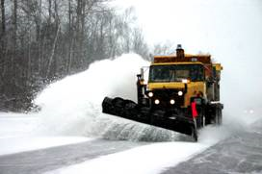
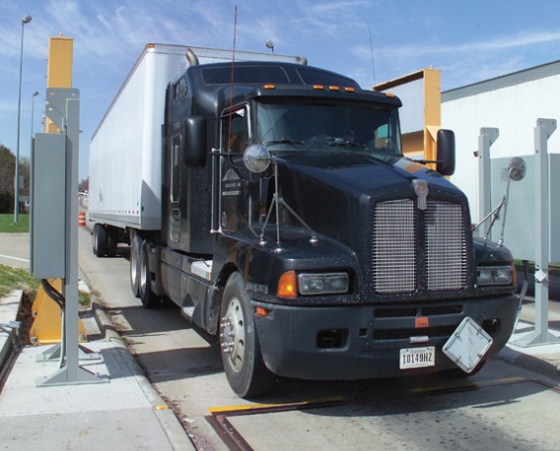
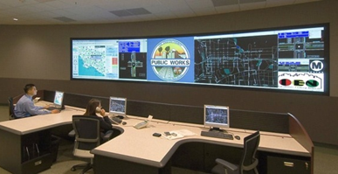
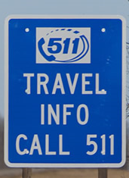
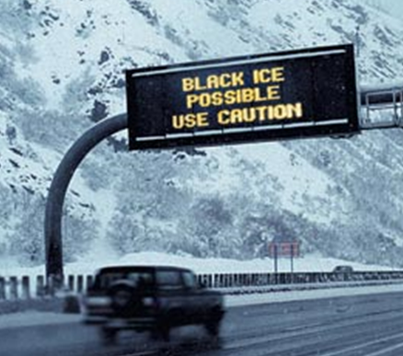
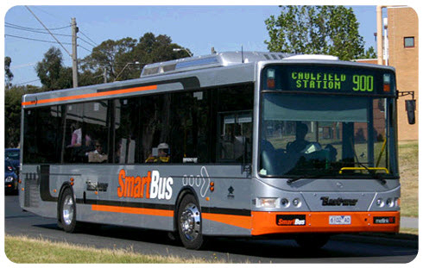


Intelligent Transportation Systems (ITS)
Use of information and communications technologies to meet transportation needs
Notes:
Purpose of Slide: Introduce that ITS systems work together to provide ITS services.
Key Message: ITS delivers services but by itself does not solve the entire transportation problem.
Time on Chart: 2 minutes
Suggested Comments: ITS addresses local transportation needs by providing information to travelers, transportation agencies and organizations so that they can make informed decisions about their travel and operations. ITS addresses the needs in the form of services that are provided such as traveler information or incident management. To provide these services, transportation systems and functions are defined that deliver the services or make them possible.
It is important to note that ITS does not solve the entire transportation problem. Congestion does not necessarily disappear after ITS is applied. ITS helps the transportation system operator manage the traffic congestion more effectively and helps the traveler make a decision that improves their travel experience.
Transition:
Interactivity:
Additional Resources:

Slide 6
ITS Addresses Transportation Needs
Delivers transportation services that address local needs
Defines transportation systems and functions needed to deliver services
ITS does not solve entire transportation problem
ITS provides tools to better manage existing transportation conditions and maximize the capacity and capabilities of current facilities
ITS enables travelers to be better informed, make safer and smarter use of transportation systems
Notes:
Purpose of Slide: Introduce that ITS is a partial solution to transportation problems.
Key Message: ITS delivers services but by itself does not solve the entire transportation problem.
Time on Chart: 1 minutes
Suggested Comments: ITS addresses local transportation needs. ITS does not increase the extent of transportation facilities, but addresses reduction in the transportation capacity of the existing facilities. By providing information to travelers, transportation agencies and organizations, ITS enables them to make informed decisions about their travel and operations. ITS addresses the needs in the form of services that are provided such as traveler information or incident management. To provide these services, transportation systems and functions are defined that deliver the services or make them possible. The systems collect data from field devices and interacting systems to allow actionable information to be communicated to the stakeholders.
It is important to note that ITS does not solve the entire transportation problem. Congestion does not necessarily disappear after ITS is applied. ITS helps the transportation system operator manage the traffic congestion more effectively and helps the traveler make a decision that improves their travel experience.
Transition:
Interactivity:
Additional Resources:

Slide 7
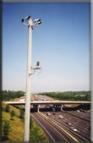
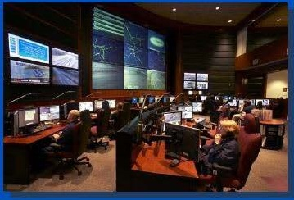
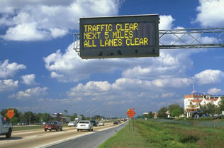
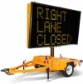
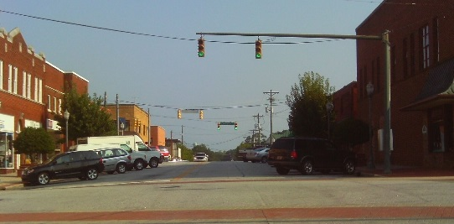
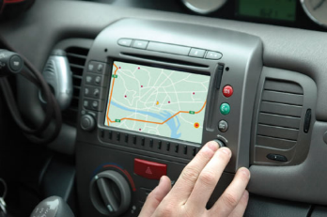
Intelligent Transportation Systems (ITS) Example
Traffic Management Center
Interacts with devices
Dynamic Message Signs (DMSs)
Traffic cameras
Highway Advisory Radios (HARs)
Traffic detection
Traffic signals
Personal Devices
Notes:
Purpose of Slide: Provide an example a common ITS deployment.
Key Message: The TMC interacts with devices to obtain and disseminate information and control devices such as traffic signals.
Time on Chart: 2 minutes
Suggested Comments: A Traffic Management Center is a common ITS implementation. Larger TMCs are housed in purpose built facilities, frequently with DOTs and other public service providers such as police, fire, rescue, and transit collocated. Smaller TMCs can be located in Engineering department offices.
To fulfill its role, a TMC will interact with a variety of field devices or other systems. Typical field devices include surveillance cameras (usually with pan-tilt-zoom capability) and traffic sensors for most centers. Centers that manage freeways additionally interact with devices such as dynamic message signs, highway advisory radio transmitters, and ramp meters. Centers that manage arterials additionally interact with devices such as traffic signals. Interaction with personal devices is becoming more common, especially for transit applications and developing Connected Vehicle applications.
Transition:
Interactivity:
Additional Resources:
Referenced TMC picture from a presentation on Georgia Navigator 511: http://fr.slideshare.net/Franciel/georgia-navigator-511
Referenced Portable DMS: http://www.coralsales.com/its/itemlist/category/43-portable-trailers-message-boards
Referenced Signal picture from Iteris, Inc.
Referenced diagram and DMS, freeway, and GPS photos from Iteris, Inc.
Referenced camera pole photo from http://www.511ga.org/#

Slide 8
Local ITS Example Instructor to modify
Local Example
Visible to students
Current developments
Recent publicity
Innovative technology
Graphics add interest
Embedding a video enlivens
the lecture
Notes:
Purpose of Slide: Provide a placeholder for additional example.
Key Message: ITS is active in the area.
Time on Chart: Up to 3 minutes depending on examples provided
Suggested Comments:
To be developed based on content added by instructor. The slide is a suggested location to add content relevant to the interests of the class. Examples of ITS in operation in the area or ITS research and development can connect potential ITS engineers with meaningful careers if the material can perk their interest.
Transition:
Interactivity:
Additional Resources:

Slide 9
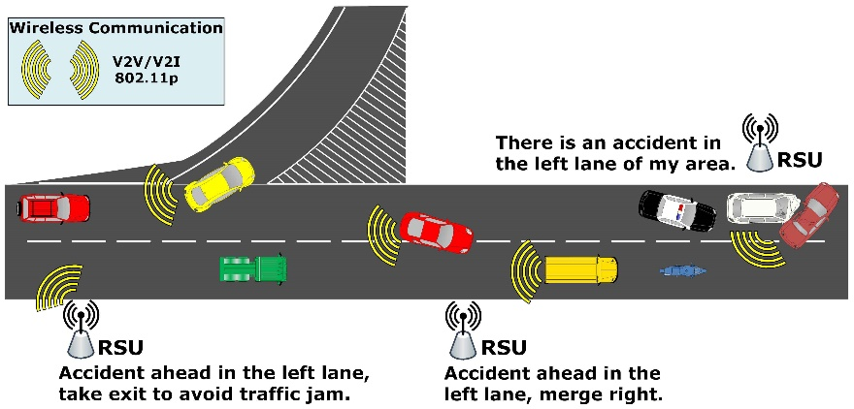
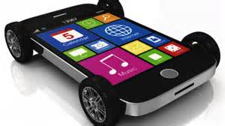
Areas of R & D
Connected Vehicles (CV)
DSRC wireless
Vehicle-to-vehicle (V2V) in NHTSA rulemaking process
Vehicle-to-infrastructure uses roadside devices to reach TMCs and service providers
Vehicle-to-everything (V2X) offers communication path to pedestrians, cyclists, others
Focused on safety and mobility
Cell phone wireless
Used existing cellular infrastructure to reach service providers
Focused on consumer-driven services
“Infotainment”
Emergency alerts
Notes:
Purpose of Slide: Introduce current research and development in Connected Vehicles
Key Message: Connected Vehicles are being introduced for safety and mobility with government initiative and consumer demand with commercial initiative.
Time on Chart: 1 minutes
Suggested Comments:
Connected Vehicles have been in research and development for a number of years. The USDOT in conjunction with agencies world wide have been defining concepts and standards to meet a wide variety of needs. The primary categories of needs are safety, mobility, and environmental benefit. In 1999, the FCC allocated a section of electromagnetic spectrum to Dedicated Short-Range Communication (DSRC). The spectrum in a 75 MHz n the 5.9 GHz band. The communication range is several hundred meters, appropriate for reaching other cars nearby and nearby traffic management equipment. Original concepts included installation of devices on vehicles (on-board equipment or OBEs) and at select locations along the roadside (road side equipment or RSEs). The ability to reach smart phones has introduced the ability to reach pedestrians, cyclists, transit passengers, and other smart phone users nearby.
In late 2016, the National Highway Traffic Safety Administration (NHTSA) issued a Notice of Proposed Rulemaking to require light vehicles to be equipped with OBEs based on compelling safety benefit predictions for vehicle-to-vehicle (V2V) applications. The NPRM foresees the possibility of devices being introduced under a mandate beginning as early as 2019.
In parallel with the government-sponsored work, auto makers have been introducing navigation and entertainment capabilities into cars leveraging cellular communication infrastructure. Many models currently have options with a variety of features. The term “Infotainment” has been used to describe the combination of information and entertainment available in cars.
As with all wireless communication, unauthorized access to the vehicle from remote locations becomes a possibility. The DSRC-based systems include significant requirements to validate all incoming messages. The infotainment applications currently have limited protections, but few incidents of harm have been reported.
Transition:
Interactivity:
Additional Resources: The USDOT JPO (https://www.standards.its.dot.gov/DevelopmentActivities/CVReference) offers information related to Connected Vehicles and related links. The announcement of the NHTSA NPRM (https://www.nhtsa.gov/press-releases/us-dot-advances-deployment-connected-vehicle-technology-prevent-hundreds-thousands) provides a number of links to explore V2V applications.

Slide 10
Areas of R & D
Automated Vehicles
Removes human driver from control of vehicle
Partial automation currently available
Automated control with human backup in trials on public roadways
Fully autonomous with no manual controls (no brakes or steering wheel) in development
Significant safety benefit is possible
Based on in-vehicle sensors, actuators, and control logic
May be Connected Vehicles also
Communication introduces security issues
Notes:
Purpose of Slide: Introduce current research and development in Automated Vehicles
Key Message: Development of capability for automation resident on cars to take over some or all of the driving task is advancing rapidly.
Time on Chart: 1 minutes
Suggested Comments: Development of automated driving capability has been a concept being considered since at least the 1930s, with major research initiatives taking place in the 1970s and the 1990s. Capabilities such as cruise control and lane-keeping have been gradually introduced to where some cars can operate in certain circumstances without driver control. In 2016, trials of prototypes began in limited areas where cars would take passengers from origin to destination without driver action.
SAE International, originally know as the Society of Automotive Engineers (SAE), categorizes the level of automation between Level 0 and Level 5. Level 0 includes no automated control. Level 5, which is fully autonomous, leaves control of the vehicle entirely to the automated control. The intermediate levels share responsibility for control of the car between the vehicle and the driver. The car increasingly senses its environment, determines needed actions, and controls the vehicle. Sensing is done using a variety of cameras, radar, and vehicle motion detection. Determination of needed actions is accomplished using computing capability on the car with specially-designed logic. The control of the vehicle is done with actuators previously controlled through driver controls including steering, acceleration, and braking.
A majority of crashes involve human error. In gradually taking the control of the car away from the human driver, a significant number of these crashes can be avoided. Enabling the legal and insurance support for the crashes that continue to occur or new types that may be introduced is an issue being considered in many locations including insurance companies, auto manufacturers, and lawyers offices, and legislatures.
Currently, Automated Vehicles rely on the capabilities resident on the vehicle with limited or no reliance on Connected Vehicle resources. The CVRIA specifically excludes inclusion of vehicle control. The incorporation of Connected Vehicle capabilities including safety information has potential to reduce exposure to crash scenarios that on-vehicle sensors cannot fully mitigate. For example, an automated vehicle in a line of vehicles that include a high vehicle may only be able to detect the vehicles behind the high vehicle. An emergency stop by a vehicle ahead of the high vehicle could not be detected until the high vehicle begins to slow, leading to the potential for a rear-end collision. If, however, the leading vehicle and the autonomous vehicle both had OBEs including an Electronic Brake Light application, the emergency stop could be initiated by the autonomous vehicle even before the high vehicle begins to slow, reducing the chances for the rear-end collision for the autonomous vehicle as well as vehicles behind it.
As introduced with Connected Vehicles, the use of wireless communication exposes the Autonomous Vehicle to the risk of erroneous or malicious messages. In an Autonomous Vehicle, the automation itself must be capable of discarding the message to preserve the integrity of the vehicle control.
Transition:
Interactivity:
Additional Resources: The USDOT JPO offers introductory information related to Automated Vehicles (http://www.its.dot.gov/automated_vehicle/index.htm).

Slide 11

Putting ITS Together
APTS
ATMS
ATIS
cvo
EM
MCMS
ITS has many systems, interactions, and institutions
How does it all fit together?
How do the various components interact?
What can be used to coordinate deployment?
USDOT defined the National ITS Architecture Guide for ITS deployment planning
Connected Vehicle Reference Implementation Arhcitecture (CVRIA) incorporates CV concepts
Notes:
Purpose of Slide: Introduce the National ITS Architecture via its purpose.
Key Message: ITS has diverse components and a framework is needed to connected the various components.
Time on Chart: 2 minutes
Suggested Comments: ITS brings together different modes (transit, traffic, freight, rail), using different communications media (wireless, wireline, vehicle to vehicle), and numerous organizations (state/local government, law enforcement, emergency management, private industry). The benefits of ITS are realized when all of these systems are able to efficiently coordinate their operations and easily exchange the information they have and need. To accomplish the integration of ITS a framework is needed to functionally describe the subsystems required, the information exchanges needed and the institutions who operate each subsystem. That framework exists as the National ITS Architecture. Published in 1996 at the direction of Congress and under the management of USDOT, the National ITS Architecture provides a functional representation of ITS for organizations to plan and deploy their ITS in a coordinated and effective manner.
Transition: The National ITS Architecture tells us what needs to be implemented and what information needs to be exchanged among system components. How we translate that to an actual system to deploy, requires a structured process.

Slide 12

Using Standards
Standards are published documents that establish specifications to improve reliability and interoperability
For ITS, standards:
Define an architecture of interrelated systems that work together to deliver transportation services
Are developed in conjunction with Standards Development Organizations (SDOs)
Cover a wide array of topics
Interaction among ITS components are aided through standards
Notes:
Purpose of Slide: Introduce the use of standards to assist implementation.
Key Message: Standards reduce custom development complexity.
Time on Chart: 2 minutes
Suggested Comments: The use of standards aids in the development of products that can work as expected and work with other components. Standards that students are familiar with include the length of an inch, the size and shape of an electrical socket, and the colors of a traffic signal. USDOT work on standards related to ITS represents a significant investment in completed standards as well as continuing efforts in evolving and maintaining standards.
ITS standards are specifications that define how transportation system components interconnect and interact within the overall framework of the National ITS Architecture. They specify how different technologies, products, and components interconnect and interoperate among the different systems so that information can be shared. The National Transportation Communications for ITS Protocol (NTCIP) is a suite of standards related to the rules for communicating and the vocabulary necessary to allow electronic traffic control equipment from different manufacturers to operate with each other, supporting both interoperability and interchangeability. NTCIP was developed to support cost-effective implementation and maintenance of ITS. Additional standards related to ITS, but outside of the NTCIP suite have also been developed. Standards related to ITS cover center to center, center to field, field to field, center to vehicle, and vehicle to center application areas. USDOT has partnered with leaders in engineering, standards, and transportation industries to develop standards including the American National Standards Institute, the American Association of State Highway and Transportation Officials, the American Public Transportation Association, the Nationalo Electrical Manufacturers Associaiton, ASTM International, IEEE, the Institute of Transportation Engineers, and SAE International.
Transition:
Additional Resources: The USDOT ITS JPO provides information about current standards and the ITS standards program at https://www.standards.its.dot.gov/

Slide 13
Systems Engineering (SE)
Systems Engineering (SE) focuses on the “system” as a whole emphasizing its total operation
Views the “system” from the outside as well as the inside
Concerned about interactions of the “system” with other systems and the environment
Foundation of SE is reflecting the user needs from “system” conception through operations and retirement
Needs and requirements are traceable through implementation, testing, and evaluation
SE involves and manages multiple disciplines work together
SE is an inherent part of project management since it defines a process useful for controlling system cost and schedule
SE is all about balancing competing needs/constraints
Notes:
Purpose of Slide: Introduce System Engineering as part of the process for ITS deployment.
Key Message: ITS projects are implemented to support transportation goals.
Time on Chart: 1 minute
Suggested Comments: The International Council on Systems Engineering (INCOSE) defines Systems Engineering as “an interdisciplinary approach and means to enable the realization of successful systems. It focuses on defining customer needs and required functionality early in the development cycle, documenting requirements, then proceeding with design synthesis and system validation while considering the complete problem.” Systems Engineering (SE) can be used for ITS and transportation projects but can be used in all domains since all domains have systems
Transition:
Interactivity:
Additional Resources:
Definition quote is from US DOT ITS Systems Engineering for Intelligent Transportation Systems handbook, available on the FHWA website (http://ops.fhwa.dot.gov/publications/seitsguide

Slide 14
Civil Design in the SE “V”
Concept of
Operations
System
Validation
System
Requirements
System
Verification &
Deployment
High-Level
Design
Subsystem
Verification
Decomposition and Definition
Integration and Recomposition
Detailed
Design
Unit / Device
Testing
Software / Hardware
Development
Field Installation
Document/Approval
Implementation
Time Line
Development Processes
Notes:
Purpose of Slide: Introduce System Engineering as part of the process for ITS deployment.
Key Message: ITS projects are implemented to support transportation goals.
Time on Chart: 1 minute
Suggested Comments: Since it was first developed in the 1980s, the SE "V" model has been refined and applied in many different industries. Civil aspects of ITS projects, including portions of detailed design, implementation, and testing, are focused on supporting the implementation of the project elements.
Civil design works primarily near the bottom of the “V” for ITS projects, with the purposes and broader outlines of the project developed prior to the civil work beginning. System verification and validation occur after the completion of the civil portions of the project. Civil work will try to provide the details that enable the requirements and system design of the projects, with feedback from the civil design adjusting the higher level design on some aspects. Communication design, especially, is tied to high-level design and subsystem verification.
Test planning is initiated during the detailed design phase, including tests for civil design elements. With civil design occurring at the detail levels, the related testing verifies the capability of each component and its ability to interface with interacting components. Initial drafts of the test plan are recommended portions of the design phase, with detailed testing procedures developed concurrently with civil element implementation. Civil element implementation is not considered complete until the results from executing the test procedures have been accepted. Depending on the contract details, testing results may be reviewed for acceptance by either a prime contractor or the system owner.
Transition:
Interactivity:
Additional Resources: The system engineering “V” diagram shown above is simplified from the diagrams routinely used by FHWA. As of publication, more complete versions can be found from the Version 3 of the FHWA System Engineering Guidebook (https://www.fhwa.dot.gov/cadiv/segb/views/flash/veediagram.jpg) and the publication Designing for Transportation Management and Operations: A Primer (https://ops.fhwa.dot.gov/publications/fhwahop13013/images/f10.png)

Slide 15
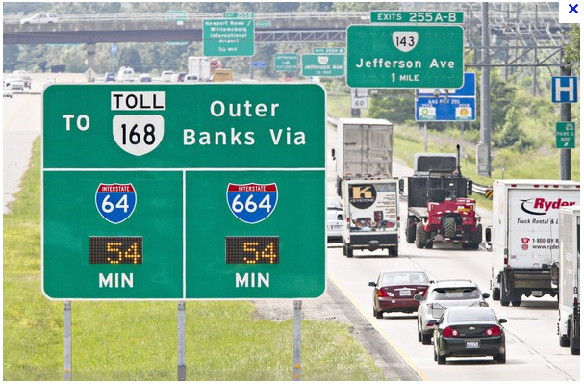
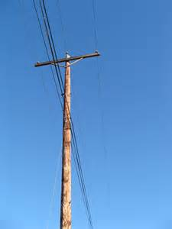

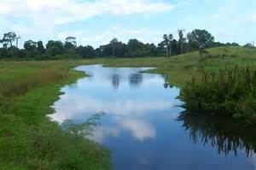
Civil Design for ITS Deployments
ITS deployments utilize multiple Civil Engineering specialties
Transportation Engineering
Roadway design
Signage
Traffic control devices
ITS
Structures
Power
Communications
ITS Messaging Standards
Utility
Hydrology
Notes:
Purpose of Slide: Introduce setting for developing civil portions of ITS projects.
Key Message: ITS is deployed into an existing transportation infrastructure.
Time on Chart: 1 minute
Suggested Comments: Civil portion of ITS projects include a variety of Civil Engineering disciplines, but the disciplines involved in each project are determined by project needs. In turn, difficulty and expense of the resulting civil design may constrain the project design. Elements of Transportation Engineering are commonly included in ITS projects and understanding of Transportation Engineering principles are important factors in ITS design. With few exceptions, ITS projects require use of new or existing structures, ranging from placing a small, light device on an existing structure to installation of significant structures to support tons of equipment. ITS projects by there nature involve powering electronic devices, requiring coordination with Electrical Engineers and power utilities. ITS projects also incorporate electronics communications, requiring coordination with communication designers as well as communication utilities. Projects near waterways and wetlands require consideration of hydrology, although ITS projects significantly impacting runoff subsequent to construction are uncommon.
Transition:.
Interactivity:
Additional Resources:

Slide 16
Typical Preconditions for ITS Projects
Existing roadway
Electronic plan sets frequently available
Some scanned plans with field markup, a.k.a. redlines
Existing signs
Existing traffic control devices
Existing cabinets
Existing conduit plant
Willingness to reuse existing infrastructure is project dependent
Nearby power and communications
Use of wireless or solar make reliable alternative
Notes:
Purpose of Slide: Introduce setting for developing civil portions of ITS projects.
Key Message: ITS is deployed into an existing transportation infrastructure.
Time on Chart: 1 minute
Suggested Comments: Almost all ITS deployments take place along existing roadways. In the unusual case of new roadways, ITS will commonly be part of the design and the roadways are typically in locations with extensive ITS infrastructure. In either case, the ITS will not be developed in isolation, but will be integrated with existing infrastructure. For most ITS, existing plan sets will exist prior to the project based on either roadway construction or prior ITS implementations. In some cases, the plans will be available in electronic format suitable for modification using CAD systems. In other cases, the electronic versions of existing plans are limited to unmodifiable scans of paper full sized plan sheets with hand-written revisions. Plans in both modifiable electronic format and plotted paper format will be required.
Leveraging the existing infrastructure can provide benefits in cost and schedule to make the difference between a project being implemented in the current funding cycle or having to be delayed until some indefinite time in the future. Previous ITS deployments can provide a framework of power and communication along with possible space in existing cabinets and conduit. Existing traffic signals can provide power and even lit static signs can provide local access to power. The ability to leverage traffic signal cabinets for housing equipment and accessing communication infrastructure is less frequent, but still an alternative to be considered. Some jurisdictions will require separation of locally-operated traffic signal cabinets from state operated ITS devices and will not consider Ethernet communication across legacy copper multipair, while other jurisdictions will accept both.
Roadways and roadway furniture provide the visible infrastructure to be leveraged. However, expansion of the conduit plant is frequently one of the most time consuming and expensive portions of a project. In general, every power and communication lead exiting a cabinet will require protection by conduit, which in most cases will be required to be underground. Power and communication leads are required to be separated, with few exceptions.
In some projects, devices will be required where existing linear infrastructure is not present. This usually occurs in rural areas, but urban freeways can have locations where access to power and communication is prohibitively expensive. In such cases, power and communication alternatives need to be considered or the entire project could be imperiled. Options for wireless communication and off-grid power will be considered later in the presentation.
Transition:.
Interactivity:
Additional Resources:

Slide 17
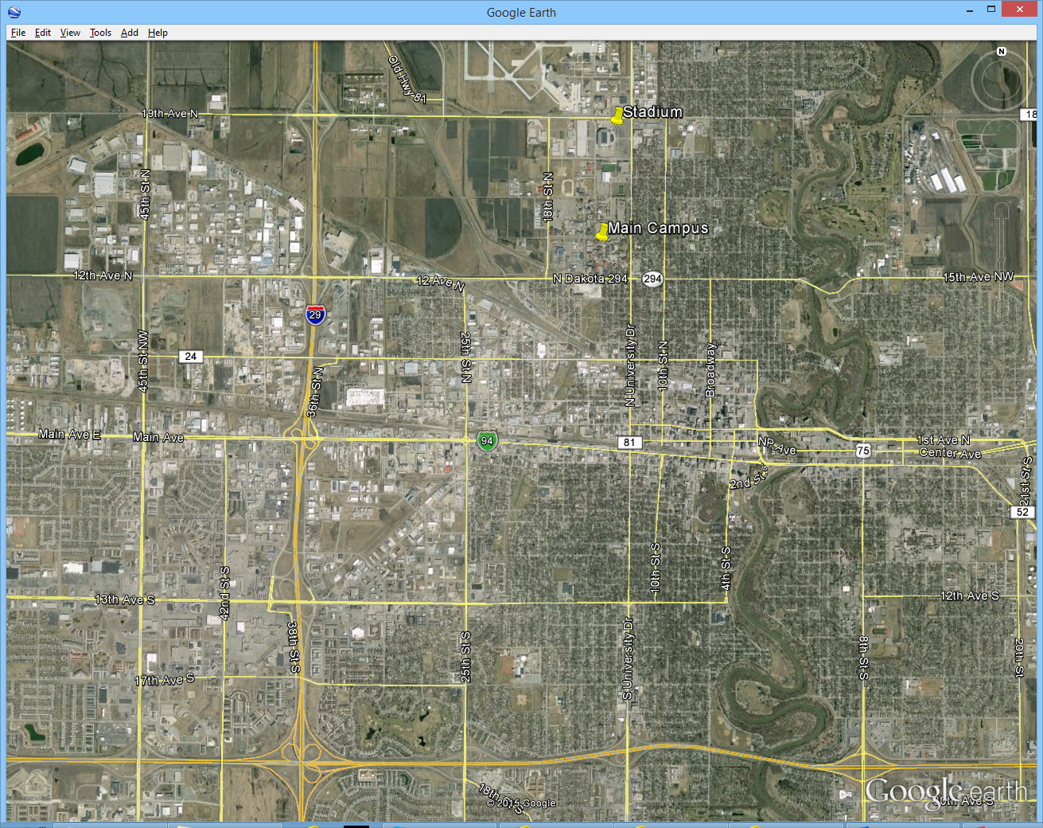
Representative Case Study
Stadium
Major
Arterial
Campus
Freeway
Interchange
Town
Center
Primary
Congestion
Secondary
Congestion
Notes:
Purpose of Slide: Present setting for the case study.
Key Message: The Case Study is a realistic scenario.
Time on Chart: 1 minute
Suggested Comments: As a representative scenario, consider a Midwestern university in a medium-sized city. The university team plays home football games at a domed stadium managed by a regional authority and shared with local events such as concerts, conventions, and community events. University football games represent the largest crowds that the stadium draws. The stadium is a quarter mile from the North edge of the campus and about a mile from the South edge. There are other university facilities up to a few miles away. For the purposes of the case study, the major arterial for consideration is 12th Avenue North, which intersects the Interstate about two miles from campus and has 7 signalized intersections to reach campus.
Transition: The capabilities for the camera to be located at the intersection of the Interstate and major arterial will next be considered.
Interactivity:
Additional Resources:
The image is take from Google Earth.

Slide 18
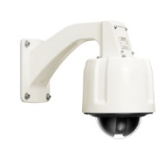
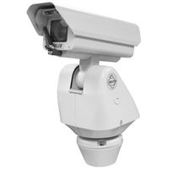
Camera Capabilities
Purpose
Collect traffic condition information
What characteristics are required to perform surveillance function?
Line of sight
Light sensitivity
Coverage (Resolution and Pan, Tilt & Zoom (PTZ))
Environmental resistance
Reliability
Power consumption
Maintenance access
Organizational standards
Legacy systems
Determined prior to civil design
Notes:
Purpose of Slide: Present major considerations in selection of camera
Key Message: Device selection is dependent on project needs.
Time on Chart: 1 minute
Suggested Comments: Prior to starting civil design, requirements should be developed for the ITS field devices to be included in the project. The ITS device requirements should trace back to user needs documented as part of the Concept of Operations development. The requirements can be found in a requirements document or in contract special provisions. The specifics of the location and application are important for the device to be selected, which will in turn constrain the civil design.
Pan-Tilt-Zoom (PTZ) cameras collect traffic condition information in the form of video images, which is typically viewed by staff at a TMC and made available with some restriction to the public via web sites. While PTZ cameras collect images that are valuable for traffic assessment, they are frequently used in conjunction with microwave, loop, or fixed camera detectors that provide a more quantitative measurement of traffic variables.
Some typical considerations for PTZ cameras provide guidance for developing a requirements specification. Once the basic characteristics are determined, a formal specification suitable for use in a procurement will be needed. Starting points for such a specification can be gained from recent state DOT procurements or model special provisions. Camera vendors will also offer procurement specifications, but care must be taken in using vendor information since they are tailored for the vendor’s product offering.
For the exercise scenario, representative capabilities of the camera (not stated as well formed requirements) include:
The camera must provide video images covering both the freeway and the arterial for a minimum of one mile.
The overpass location gives 15 feet height advantage, so that a 40 foot pole will be adequate. An optical zoom of 30X or greater with standard definition is readily available in the marketplace and will provide adequate surveillance capability.
The camera must provide video images continuously along the corridor, which will require tilt capability to -85 degrees. Such capability is typical of dome cameras, but can be met by some pedestal mount cameras.
To allow for fine adjustment on locations, PTZ speed needs to be adjustable, typically from 0.1 degrees/sec to 40 degrees/sec for pan and tilt.
For deployment in Midwestern climates such as our scenario, devices will need to operate outdoors at sub-zero temperatures. A typical temperature range required for device operation is -34° C to +74° C, which is the NEMA TS-2 environmental standard.
The camera will have to operate continuously, with typically a three-year warranty period.
With the use of grid power, low power operation is secondary. A limit of 100 Watts will limit power consumption operational costs.
The location adjacent to the arterial with a 40’ pole will allow maintenance access using a city bucket truck. Higher or less accessible installations can require use of camera lower equipment.
The city has a commitment to National Transportation Communications for ITS Protocol (NTCIP) standards and is requiring the cameras to accept NTCIP 1205 Camera Control Protocol while producing IP video meeting MPEG-4 and H.264 standards. The camera can be IP or analog with an encoder.
This is the city’s first video surveillance location, so there are no issues with compatibility with existing hardware.
Nighttime operation is of secondary importance, so high performance operation in low light is not required.
Transition:
Interactivity:
Additional Resources:

Slide 19
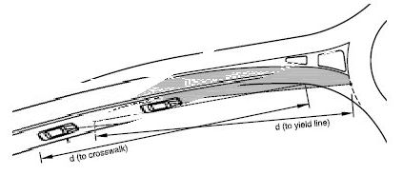

Camera Siting
Coverage of roadways of interest
Line of sight to Interstate
Northbound lanes South of Interchange is primary concern
Line of sight to arterial
At Interchange and East of interchange are primary concerns
Costs
Ability to leverage existing assets
Power
Communication
Structures
Notes:
Purpose of Slide: Present major considerations in selection of camera
Key Message: Device selection is dependent on project needs.
Time on Chart: 1 minute
Suggested Comments: Siting and civil design for ITS elements depend on a number of factors, including the horizontal and vertical curvature of the roadway near the device. Many ITS devices require line of site between roadside devices and portions of the roadway, with different types of devices differing in distance required. In the case of cameras, siting mandates visibility of the traveled way along with shoulders and medians. A frequent requirement is for continuous coverage with a minimum number of sites to minimize costs. Camera sites are frequently located on the outside of a horizontal curve near where the tangent sections would intersect and at the crest of the hill for areas with vertical curvature. Additionally, vegetation can be a driver for camera siting, including in medians. Tree trimming and removal is frequently not allowed subject to esthetic and environmental regulations. Note: Site line surveys should be done during the summer to accommodate the full extent of the vegetative blockages. In our example, the roadway has little curvature either horizontally or vertically. The sample sheet is taken from the Ohio DOT sample plans.
Transition: The following four slides present plan sheets typical of geography and existing infrastructure relevant to civil design for ITS elements.
Interactivity:
Additional Resources:

Slide 20
Plan Sheet Sample – Plan and Profile
Plan
Existing plans
General Information
Initial site line assessment
Profile
Notes:
Purpose of Slide: Present typical roadway setting.
Key Message: Design of ITS elements must fit within roadway setting.
Time on Chart: 1 minute
Suggested Comments: For most existing roadways, the plan set developed during roadway construction will show general information about topography. The plan set can provide general information to determine candidate sites and calculate site lines. Most sites will require a site survey to confirm calculated site lines. In our example, the roadway has little curvature either horizontally or vertically. The sample sheet is taken from the Ohio DOT sample plans.
Transition:
Interactivity:
Additional Resources:
This sample is taken from the Ohio DOT sample plans.

Slide 21
Plan Sheet Sample – Cross Section
Runoff and
Slope restoration
Structure
height
Standing
water
Existing plans
Siting
Environmental
Notes:
Purpose of Slide: Present typical roadway setting.
Key Message: Design of ITS elements must fit within roadway setting.
Time on Chart: 1 minute
Suggested Comments: This representative sheet shows roadway cross section elevation. The ability to take advantage of an elevated roadside can provide an advantage in line of site considerations and expense to reach a given height. However, many other situations will require additional design considerations and potentially expense to overcome. Typical conditions include:
Elevated roadway above a surrounding plain – The biggest issue is additional length of a structure to reach the required height above the roadway.
Ditch or pond beside roadway – In addition to the length of pole, surface and subsurface water has potential implication for water quality and wetland remediation.
Slope – Any construction with a significant slope requires additional construction effort for restoration and run off remediation.
Clear zone/guard rail – Placing an object in the clear zone can require protection with guard rail. A slope of more than 1 Vertical: 6 Horizontal can increase the size of the clear zone and the need for guard rail.
The sample is taken from the Michigan DOT sample plans.
Transition:
Interactivity:
Additional Resources:

Slide 22
Plan Sheet Sample - Intersection
Conduit Plant
and Usage
Cabinet
Location
Potential Mounting
Structures
Roadway
Dimensions
Notes:
Purpose of Slide: Present typical roadway setting.
Key Message: Design of ITS elements must fit within roadway setting.
Time on Chart: 1 minute
Suggested Comments: Siting and civil design for ITS elements depends on a number of factors, including existing signalized intersections. Signalized intersections are the most common electronic traffic control device and have been in use for over a century. Modern installations include significant detail in operational plan and significant electrical and conduit plant surrounding the intersection. In addition to power for the signal heads, power needs to be distributed to the signal cabinet, crosswalk signs, and any powered traffic sensors. Data leads need to reach from the traffic signal controller to any loops, sensors, and changeable signs, and possibly to a communication network. Each lead needs to be protected by conduit, with adequate handhole or manhole access for maintenance.
Many existing traffic signals still operate without communication to surrounding intersections, while an increasing number coordinate with other nearby intersections. The most common communication medium to a signalized intersection is copper multipair, which began being commonly installed in the 1970s for low data rate communication. Some more recent, higher bandwidth communication media include wireless Ethernet and optical fiber as well as upgraded electronics to gain high bandwidth from legacy multipair.
Maintenance of existing operation is a primary requirement for ITS projects leveraging infrastructure used by traffic signals. Plans for operation during construction and testing and operational changes following construction (if any) need to be developed and approved. In situations where the ITS project is sponsored by an agency other than the one operating the traffic signals, significant coordination can be required to demonstrate noninterference with the signal operation. Issues include physical access, physical security, electronic access, electronic security, sharing of communication infrastructure, and cost sharing for power and maintenance.
In our example, the intersections along the arterial corridor will receive improved vehicle detection and have existing multipair communication infrastructure. While the operating agency is also the implementing agency, which will reduce interagency coordination, traffic signal timing plans and coordinated corridor operation will need to be developed or revised. Our exercise will not involve location of the new camera in or near an intersection.
The sample is taken from the Minnesota DOT sample plans.
Transition:
Interactivity:
Additional Resources:

Slide 23
Plan Sheet Sample - Interchange
Roadway
Dimensions
Cabinet
Location
(if present)
Traffic
Estimates
Potential Mounting
Structures
(if present)
Conduit Plant
and Usage
(if present)
Notes:
Purpose of Slide: Present typical roadway setting.
Key Message: Design of ITS elements must fit within roadway setting.
Time on Chart: 1 minute
Suggested Comments: Intersections between freeways and arterials provide the most likely interaction between different agencies. Typically, state departments of transportation operate the freeways. Depending on the jurisdiction and the roadway classification, state, county, or city governments can operate the arterial and therefore will be responsible for traffic signals at the ends of the ramp, if present. Coordination between the operating agencies is required for normal operation and for special events.
In our exercise, the city has operational control over the arterial at the freeway interchange and has decided to locate a camera to monitor both the arterial and the freeway.
The sample is taken from the Illinois DOT sample plans.
Transition:
Interactivity:
Additional Resources:

Slide 24
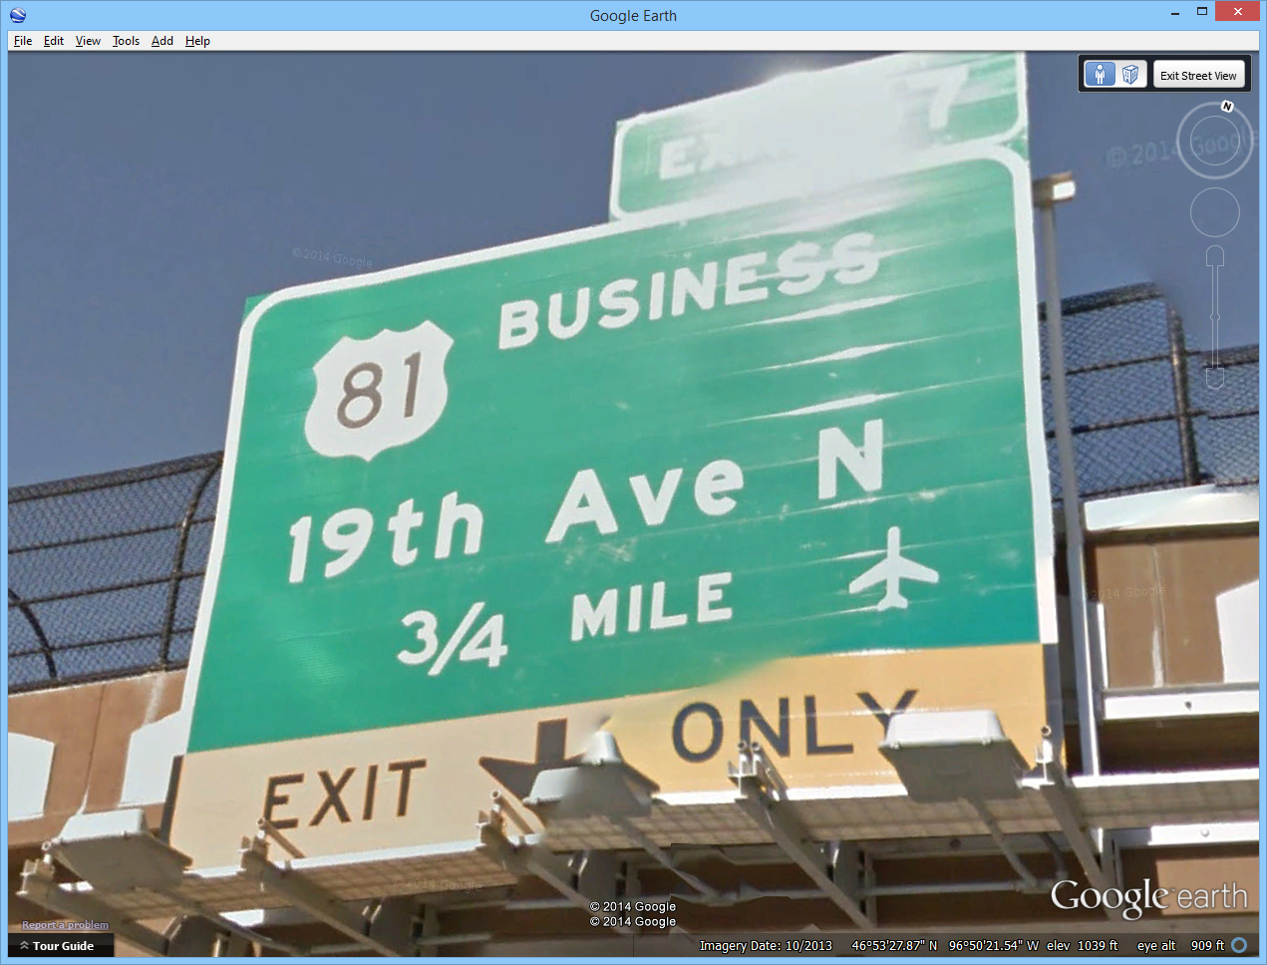
Power
Required to operate electronic devices and communication equipment
Need stable, clean power supply
Plans require coordination with Electrical Engineer
Most commonly gained from regional power company
Distance from existing infrastructure drives costs
Possible to use existing power drop from existing cabinet
Microgrid alternative in some cases
Low power application (e.g. unheated camera)
Location remote from power infrastructure
Adequate insolation or reliable wind
Some applications require backup power
Notes:
Purpose of Slide: Present consideration for selection of power supply.
Key Message: Power design is based on goals of the project.
Time on Chart: 3 minutes
Suggested Comments:
ITS devices require electrical power to operate. As with the devices, the power design must support the user needs and requirements derived from the user needs. To accomplish the user needs, ITS devices need highly reliable power for continuous operation. Most commonly, power is obtained from a regional power company that does business with the system owner. Tying into the utility grid requires coordination with the utility and the services of an authorized Electrical Engineer to develop plans for approval. The biggest design drivers are installation cost, recurring costs, and reliability. For utility power, the most economical option is access to an electrical outlet in an existing cabinet. Capacity considerations, distance to the cabinet, and organizational considerations affect the ability and benefits of this approach.
Specialized applications can require additional devices to augment grid power. Applications to support emergency operations such as traffic surveillance along an evacuation route can demand high reliability operations for cameras and communications devices in the presence of extensive outages to the power and communication infrastructure. Operation of traffic control or traveler information devices can justify isolated operation support or outage reporting capability for shorter durations or localized power outages. Localized instability of grid power can justify conditioning equipment, even if protection against power outages is not necessary.
Using power sources outside of the utility grid should be considered when access to utility power requires significant investment.
In our example, the utility grid is close to the interchange, so that power access is readily available.
Coordination with the state has been performed. The state not only approved the siting of the camera near the freeway, but has also offered to share the existing power drop used to light an existing static sign on the interchange overpass in exchange for access to the video stream. The existing riser is 100 feet from the desired camera pole, so the city has accepted the offer of power.
Transition:
Interactivity:
Additional Resources:

Slide 25
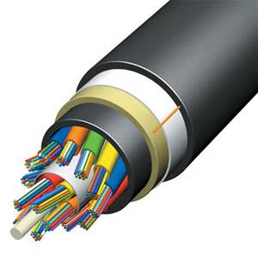
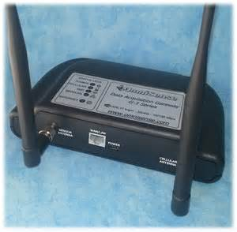
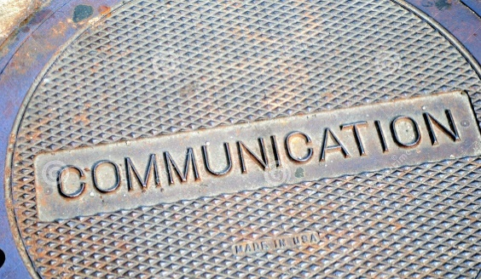
Communication
Specific plans required to access all locations with communication need
All choices must support user needs and requirements
Bandwidth
Reliability
Security
Extensive range of options available
Distance from existing infrastructure drives costs for wireline
“Last mile” may be different than trunk
Reuse of existing infrastructure most cost effective
Notes:
Purpose of Slide: Present options for communication from the field site to the user location.
Key Message: A wide variety of communication alternatives are available, but almost all now carry Ethernet data traffic.
Time on Chart: 3 minutes
Suggested Comments: The number of communication alternatives available continues to increase, with the cost and performance of the connection improving. No selection is correct for every location. A communication study can be useful for initial deployments or deployments outside of existing infrastructure.
As with power, the communication choices are driven by the user needs and requirements derived from the user needs. Several basic choices will constrain the selection. Some of the basic characteristics of communication selections include bandwidth, reliability, and security.
The initial determinations are the use of private or commercial infrastructure and wireless or wireline media. Frequently, installation cost is a major consideration, which will argue for use of either wireless communication alternatives or commercial alternatives. Depending on funding source, installation costs may be covered by grants or federal programs, while ongoing costs will be obtained from local operating budgets, which argue for owned infrastructure. The ability to reuse existing infrastructure can alter cost factors sufficiently to change final selection. Infrastructure to consider reusing includes conduit plant, cabling, cabinets, and structures.
For the exercise scenario, standard definition video at 30 frames per second requires about 500 kbps for acceptable appearance and up to 4 mbps for full resolution. The camera is located 2000’ from existing city communication infrastructure, which is copper multipair to the next intersection toward town. The options being considered are wireline using City infrastructure, a wireline/wireless hybrid using City infrastructure, Internet from the cable company, and wireless Internet from the local cellular provider. All of the following costs are accurate only in order of magnitude estimate.
For any wireline option, reaching between the camera location to the intersection is a $50K or greater prospect with much of the cost being installation of new underground conduit. With current technology, the preferred wireline alternative would probably be to reach from the camera to the intersection with fiber and then reach back to the Engineering Department at City Hall over two or three DSL hops on the legacy multipair. In order of magnitude, the electronics for the DSL upgrade would add another $10K.
Using a wireless hop to cover the camera to intersection segment would reduce the initial costs to about $3K, at the expense of some reliability and exposure to security issues. The City IT department has assessed security countermeasures and has determined the risks to be low and able to be isolated to the camera network.
Since the location is near the freeway and away from residential areas, the cable company does not have any infrastructure closer than the nearest intersection and no plans to expand in the area. They would charge the City for installation about the same $50K and then a $50/month fee for Internet data service.
The cellular provider has recently installed 4G data infrastructure that offers 5 mbps uplink and will offer the City an unlimited service option at $200/month.
With these options, the installation costs for the wireline options to the camera (options 1 and 3 above) are prohibitively expensive. While the installation cost of option 2 exceeds that of option 4 by about 5 years of operational costs, the installation budget of $15K is determined acceptable while the ongoing $2.4K annually to the cellular company is considered unacceptable. Option 2 will be proposed as the preferred alternative for further analysis.
Transition:
Interactivity:
Additional Resources:

Slide 26
Mounting Structures
Existing structure
Major advantage is cost
New structure
Location
Soil condition
Protection from traffic
Height
Strength
Load of device
Load of cabinet
Cabinet mounting
Notes:
Purpose of Slide: Present alternatives for camera mounting.
Key Message: Mounting of a camera is a traditional structure issue.
Time on Chart: 1 minute
Suggested Comments: Selection and design of mounting structure is dependent on costs and local preference. In some locations, cameras are mounted on existing structures, essentially eliminating mounting costs. Typical existing structures include traffic signal poles, communication towers, and city buildings such as parking decks and office roofs. Other locations require dedicated camera poles similar to roadway structures such as luminaires. For the exercise scenario, no existing structure is available, so we will be designing a 40 foot pole near the intersection overpass. A pole mount cabinet similar to a 336 cabinet will be used to house the camera and communication electronics. While a camera has not been selected, the weight has been specified as 15 pounds or less and the cross section at 300 square inches or less. The camera has to be operational in 90 mph winds and withstand 150 mph winds.
Transition:
Interactivity:
Additional Resources: Boring log taken from Grand Rapids, Michigan

Slide 27
ITS Device Integration and Testing
Devices must operate to meet requirements
Testing needs to show device characteristics to integrate with system
System compatibility
Standards
Test plans need to be linked back to requirements
Testing should be incremental and progressive
Frequently test plans for each device and an integrated system test plan need to be developed to test all requirements
Notes:
Purpose of Slide: Introduce the topic of integration of devices into a system.
Key Message: ITS elements are of limited value in isolation.
Time on Chart: 2 minutes
Suggested Comments: While civil design does not have significant impact on the higher level goals of the project, devices and services need to be tested as working properly and prepared for integration into a system. Each capability required should be tested thoroughly, but once tested only needs to be reconfirmed with regression tests in more integrated settings. In our case study, the camera can work perfectly on a lab bench, but has to be shown to work properly on the mounting structure to be of value to the project. However, if the camera has the details of its preset requirements shown in the lab, only a subset of the preset requirements need to be reconfirmed once it is installed. In the exercise scenario, the portable DMS will work in isolation, being controlled by a staff member at the roadside, and the video traffic detectors will be considered to work properly if the local traffic signal controller receives detection signals properly. The camera not only has to be working properly and the communication network has to meet requirements, but the camera has to be reliably usable from the City TMC across the communication link. The integration with existing systems is greatly simplified if all elements implement standards, most notably the NTCIP suite. Responsibility for testing is shared between the civil designer, the device installer, and the system integrator.
Transition:
Interactivity:
Additional Resources:

Slide 28

Other Issues
Each agency will have a set of topics that must be addressed
Departmental checklists provide most topics
Representative issues considered include
Infrastructure protection
External regulations
Coordination with other contractors
Notes:
Purpose of Slide: Introduce approval process.
Key Message: Designs are inevitably revised during construction.
Time on Chart: 1 minute
Suggested Comments: This course has considered items routinely included in the process of preparing civil design elements for the implementation of infrastructure portions of a project. Each project will additionally have considerations required that are unique to its location, jurisdiction, environment, technology, and design choices. Many jurisdictions use a checklist in the formal review. Reference to the checklist is a highly recommended practice during the project design and implementation.
In addition to items on the checklist, new issues may appear at any time during implementation. The topics listed on this slide are presented for exposure to issues that may arise and will be of varying importance based on project specifics. These representative topics are far from an exhaustive list.
Transition:
Interactivity:
Additional Resources:

Slide 29
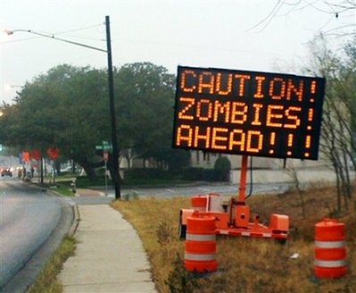
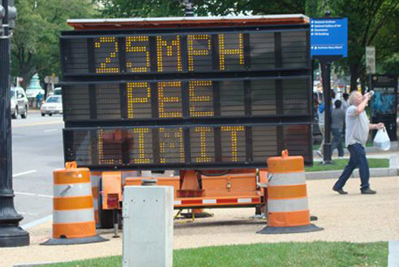
Infrastructure Protection
Surge suppression and grounding
ITS infrastructure is frequently the tallest object in an area
Lightning suppression frequently required
Surge suppression is required for all copper leads exiting a cabinet
Protection from weather
Heat
Cold
Moisture/sunlight
Infestation
Physical security
Electronic security
Notes:
Purpose of Slide: Introduce need for protection in design.
Key Message: Risks come from environmental, use conflict, and vandalism sources.
Time on Chart: 2 minutes
Suggested Comments: ITS components reside in a harsh environment and will eventual fail. A typical design life is 10 years, with many components lasting longer. They are constantly under attack from the elements.
Catastrophic failures are most commonly associated with lightning strikes. ITS components frequently extend higher than surrounding structures and vegetation for visibility advantage. They also frequently have copper communication leads extending up to thousands of feet in several directions. This makes them attractive targets for lightning. Grounding and surge suppression and lightning arrestors can assist in protecting the electronics.
Protection from weather is a traditional part of transportation engineering. For ITS, sunlight will degrade antenna leads or other above-ground wiring, while moisture is an issue both for above-ground and underground elements. Aerial elements are subject to wind and rain as well as extremes of temperature. Elements in cabinets are largely protected from water and the most extreme cold temperatures, but solar gain on a hot day can leave a cabinet over 120° F and DMS panels receiving direct insolation over 165° F .
ITS elements are installed into a world with vermin. Insects can use cabinets as locations for nests, especially bees and ants. These usually don’t cause damage to equipment, but can make access for maintenance more difficult. Rodents (especially mice) use cabinets and conduits as shelter and can sever cables. Fiber optic cables offer little resistance to rodent damage.
The infrastructure deployed offers value for thieves as well as targets for vandals. The cabinet doors have been known to be stolen for scrap value. Physical security also supports electronic security. A lock and key is standard practice. Pad locks and removable handles are common. Best practices include monitoring of the cabinet when being opened or when it goes off line. Sometimes, the attack can be foiled, but more frequently the benefit is an improved response time for restoration of service.
Electronic security protects the local devices as well as all network elements connected. This is currently an industry risk. Standard practice is to use only wireline communication and offer no security beyond physical security. This means that access to a single cabinet can offer an attack point to any device connected, including traffic signal controllers and DMS. Best practices disable unused ports, require username/password credentials (15 character complex per site), and limit access based on IP address and MAC address. Wireless access points require additional security considerations.
Transition:
Interactivity:
Additional Resources:

Slide 30
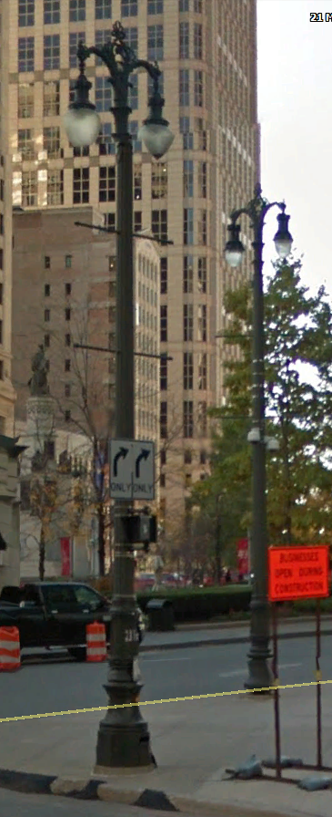

External Regulations
Aircraft protection
Environmental Impact
Waterways
Endangered species
Jurisdictional requirements
Aesthetics
Departmental infrastructure ownership
ITS
Camera
Architectural Pole
Notes:
Purpose of Slide: Introduce external regulations.
Key Message: Roadway work takes place in an environment with extensive regulations and constraints.
Time on Chart: 1 minute
Suggested Comments: Non-transportation regulations can impact the ITS design process.
Non-transportation regulations that can impact the civil design process are environmental impacts and jurisdictional requirements. Environmental regulations restrict locations for navigable waterways and protection of endangered species place constraints on civil design. The restrictions can cause relocation of devices, which can potentially increase costs and require additional field sites to meet project requirements. A more difficult situation to overcome is a location such as a waterway with an endangered species resident in it that represents a barrier for linear infrastructure such as conduit for wireline communication. Such a barrier can prohibit the desired alternative, requiring significant budget and schedule impact to reroute the infrastructure or install alternate media.
All ITS projects take place in the unique regulatory environment of the local deployment. Zoning regulations can limit the location, height, and appearance of structures, most typically impacting camera mountings. Initial installation of conduit infrastructure in developed locations can grant ownership of underground infrastructure to local power companies, local telephone companies, or city street or lighting departments. In such cases, the inventory and routing of unused conduit in a duct bank can restrict power and communication alternatives.
FAA regulations place requirements on towers over 200 feet everywhere and any structure near an airport. The representative location of Fargo, ND has an airport within ¼ mile of the arterial. An obstruction evaluation tool is available from the FAA (https://oeaaa.faa.gov/oeaaa/external/gisTools/gisAction.jsp?action=showNoNoticeRequiredToolForm).
Transition:
Interactivity:
Additional Resources:
Transition:
Interactivity:
Additional Resources:

Slide 31
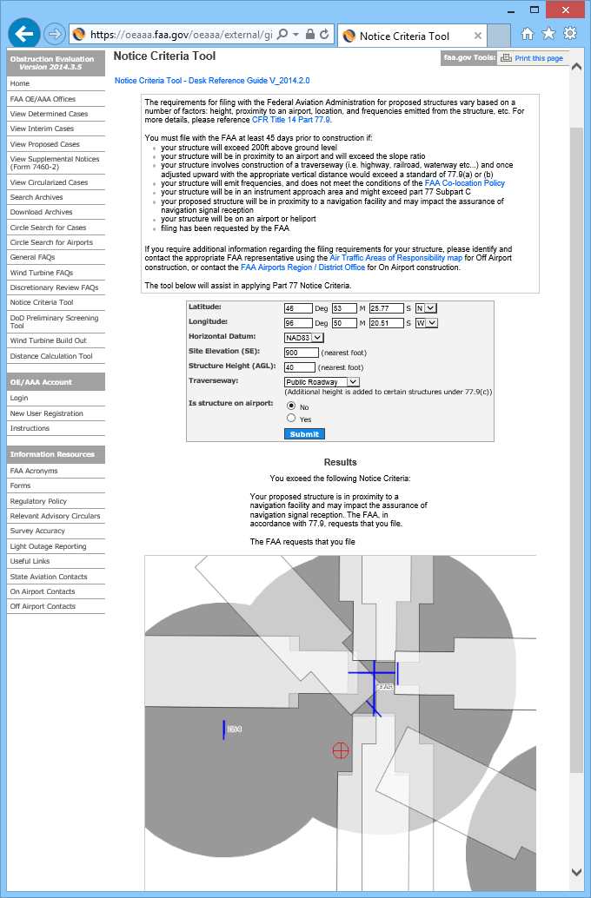
FAA Notification Results
Further FAA coordination is required
Notes:
Purpose of Slide: Demonstrate the applicability of regulations.
Key Message: Demonstrate the applicability of regulations.
Time on Chart: 1 minutes
Suggested Comments: The presence of a regional airport near the sample site requires notification of the FAA.
Transition:
Interactivity:
Additional Resources:

Slide 32
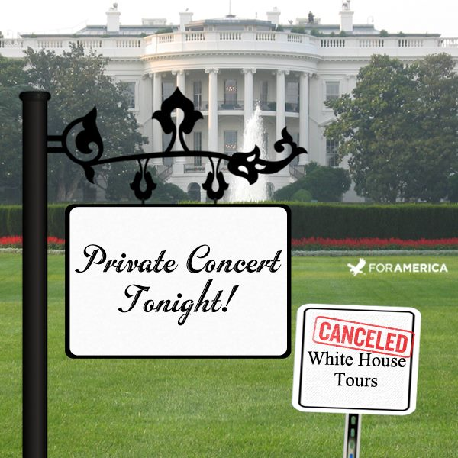
Coordination with Other Contractors
DOTs frequently have several concurrent projects impacting a single section of roadway
Typical in location with a short construction season
Scheduled projects can be included in plans and budgets
Emergency work can result in contract changes for impacted projects
Coordination of access for field work is the most common impact
Coordination can be achieved with regular meetings or teleconferences
In high-traffic areas, coordination of lane and shoulder closures is required
Occasionally, projects directly conflict with each other
Notes:
Purpose of Slide: Introduce project coordination.
Key Message: Other projects in the area can impact implementation and operation
Time on Chart: 1 minute
Suggested Comments: The progress of projects in a regional or agency plan occasionally conflict. An area with a long winter can have a short construction season. Other factors such as event venues will also constrain the time periods when extensive work can take place. Locations with delayed infrastructure maintenance can experience a flurry of projects when issues reach a crisis or outside funding becomes available. In most cases, the other active projects are known in advance and can be incorporated into design plans and implementation budgets.
The most common type of impact is the need to coordinate field work using periodic meetings. During the most active conflicts, daily meetings may be justified. More commonly, weekly or monthly teleconferences can be sufficient. If the interaction is limited, coordination through public agencies during routine management meetings might be sufficient.
Transition:
Interactivity:
Additional Resources:

Slide 33
Local ITS Example Instructor to modify
Regional issues
Weather
Snow
Heat/Cold
Fog
Flooding
Business
Ports/Commercial vehicle
Agriculture
Tourism
Culture
Festivals
Religious observance
Graphics add interest
Embedding a video enlivens
the lecture
Notes:
Purpose of Slide: Provide a placeholder for additional example.
Key Message: ITS is active in the area.
Time on Chart: 1 minute
Suggested Comments:
To be developed based on content added by instructor. The slide is a suggested location to add content relevant to the interests of the class. Specific topics unique to a region can connect with student interest.
Transition:
Interactivity:
Additional Resources:

Slide 34
Review and Approval
Internal review in line with Quality Assurance
Sign and seal by qualified PE(s)
Submittal to agency for acceptance
Review comment disposition
Use of a checklist is beneficial
Notes:
Purpose of Slide: Introduce approval process.
Key Message: Review and approval phases are elements of all projects
Time on Chart: 1 minute
Suggested Comments: The development of complete and correct plans is only a portion of the design process. The process for each project will be determined by a combination of the implementing agency’s processes and the design company’s processes. Once a design is considered complete and correct by the design team, many companies have internal Quality Assurance/Quality Control processes that must be followed prior to delivery of any product. Additionally, many contracts are requiring approval of a quality process in the award of the contract. For most plan sets, the concurrence of a Professional Engineer registered in the state of implementation is required as indicated by having the PE affix his/her seal and signature to the plan set. After the plan set and other submittals are provided to the implementing agency, that agency must indicate its concurrency that the plan set is adequate for implementation by the issuance of a release for construction or issuance of a notice to proceed on a construction contract. The disposition of comments from the implementing agency can be a time consuming process both in labor hours and in calendar time. It is typical for there to be a tension between the desire for initiation of construction and the desire for all identified issues with the plans to be resolved.
Many jurisdictions use a checklist in the formal review. This is a highly recommended practice during preparation for the submission to QA.
Transition:
Interactivity:
Additional Resources:

Slide 35
Design Revisions
Most projects are implemented differently than designed
Typical revisions during civil construction
Existing plan sheets obsolete/inaccurate
Unexpected field conditions encountered
Design not constructable
Design inconsistent with policy
Impacts range from minor notes to project cancellation
Notes:
Purpose of Slide: Introduce concept of field revisions.
Key Message: Designs are inevitably revised during construction.
Time on Chart: 1 minute
Suggested Comments: For a variety of reasons, implementation of designs differ from plans made during the design phase. Sometimes the design starts at a point that is not realized in the field. Sometimes a project has been implemented that the plan sheets do not reflect, such as a device put in “temporarily” that managers decide to leave or an emergency restoration to a nearby installation that is not recorded. Other times field conditions are encountered that predate the records, such as an oil tank left from a house taken by eminent domain or an endangered species found on an environmental survey for a nearby development. Other times, the designer just makes a poor decision, such as placing a wireless path near a treetop that becomes occluded or placing a wireless path near a building under construction that increases in height to block the path.
In ITS, frequently projects are put in place when traffic conditions are congested, which places the project in the eye of politicians. Political decisions on transportation priorities can cause a project to be revised during implementation or canceled altogether. Other policy changes, such as a mandate for increased electronic security, can cause significant revision to configuration or devices.
Any significant revision can cause implementation to stop for anywhere from a few hours to into the next budget cycle. If the interruption is significant enough to significantly impact costs, the implementing agency may require adjustment to the extent of the project or may reallocate the remaining budget to other priorities, leaving the original project partially implemented.
In response to revisions, standard practice is for a project to issue design revisions. Most commonly for minor changes, the implementing agency will allow plans to be “redlined”, with either a handwritten change being noted on the paper plans or an electronic change being noted in the files as construction continues. For more significant revisions, the implementing agency may require the plan set to be reissued and go through an approval process, with further progress on the construction being delayed until approval is complete.
While each of these possibilities is unlikely, projects without some change to the plan are rare.
Transition:
Interactivity:
Additional Resources:

Slide 36
Integration and Testing
Civil work takes place at bottom of SE “V”
Test plans and procedures are developed during the design phases
Testing takes place against project requirements
Compliance with each requirement must be demonstrated to complete a project
Infrastructure supports functional requirements
Infrastructure must meet some maintenance and reliability requirements
Operation of an unaccepted system is a common, risky practice
Notes:
Purpose of Slide: Introduce concept of required testing.
Key Message: A project is not completed until test results are accepted.
Time on Chart: 1 minute
Suggested Comments: Civil design work and infrastructure elements of a project take place at the bottom of the System Engineering “V”. If the project is properly advancing, requirements at this portion of the project are specific and testable. While infrastructure work is in a support role to the transportation function, a subset of the requirements must be supported by the infrastructure elements. In the scenario considered, the camera pole must support project requirements for site line requirements. Power supplied must meet usage and reliability requirements.
Development of test plans and procedures should begin during the design portion of civil work to assure resources needed to test compliance with requirements are available in a timely manner. Providing the resources to accomplish test planning during the design phase is a frequent shortcoming of ITS projects.
Operation of a system prior to the acceptance of the project is a common practice that has many downsides. The pressure to initiate operation of the results of a project comes from both the agency and the implementer. The agency has a need defined for the project and frequently feels political pressure both to meet a schedule and to gain benefit from fielded devices that are visible to the public. The implementer also frequently feels pressure to meet a schedule as well as to achieve a milestone that will trigger a payment. Milestones such as operational acceptance or substantial completion are typical. The biggest downside of granting those milestones is the removal of the urgency to promptly complete the remaining work. A contractor with substantial completion achieved may redeploy key assets (both staff and equipment) to other projects with a more urgent need. Correcting less urgent defects or implementing the remaining requirements may be delayed or offered as subject of a variance to the project requirements to never be met. Implementing and testing remaining requirements can be vastly complicated by doing so with the system in operation, with significant cost and schedule implications for the implementer. Also, initial operation may reveal desired improvements that the agency wants to get in promptly, making completion of the project difficult to claim by the implementer.
Transition:
Interactivity:
Additional Resources:

Slide 37
Evaluation
“Reasoned consideration of how well project goals and objectives are being achieved”
Evaluation initiated early in ITS program
Currently written based on SAFETEA-LU in 2005
Updated frequently
USDOT Evaluation Guidelines online at http://www.its.dot.gov/evaluation/eguide_resource.htm
Best performed by independent analysts
Self-evaluations acceptable in some cases
Evaluation planning occurs during project planning
Notes:
Purpose of Slide: Introduce
Key Message: Performance measures must be identified based upon the objectives of a project.
Time on Chart: 1 minute
Suggested Comments:
Evaluation assesses the accomplishment of project goals. Civil design considerations should support the goals and may require accommodation of evaluation requirements in support of such an assessment. The planning for the evaluation should be approaching completion during civil design work.
The USDOT ITS program has been encouraging, guiding, and performing evaluations since the 1990’s. Authorizing legislation (ISTEA, SAFETEA-LU) includes mandates for evaluation of government resource expenditures. The current reporting and evaluation guidelines along with links to resource guides and sample evaluations are available online.
Evaluation is a separate effort from the implementation of a project, requiring independence on the part of the evaluators to examine the project and measure its effectiveness. Reporting of negative results and incomplete achievements may be difficult for project partners to accept, but can also lead to project revisions that improve the project.
Transition:
Interactivity:
Additional Resources:
Definition taken from USDOT ITS JPO ITS Evaluation Guidelines retrieved from website on August 24, 2015
Examples of completed evaluations are linked to the appendix of the online guide.

Slide 38
ITS Performance Measures for Evaluation
Identified based upon goals and objectives
Can be qualitative or quantitative
Should be easily obtained
If MOE not available, less direct surrogates can be collected
A single project can address multiple goals
MOEs should be selected to assess each goal
Notes:
Purpose of Slide: Present use of performance measures for evaluation.
Key Message: Performance measures must be identified based upon the objectives of a project.
Time on Chart: 2 minutes
Suggested Comments:
Performance measures address issues at a higher level in the System Engineering “V” and must be based upon the objectives of the project, which reflect the transportation need (i.e. problem) being addressed. If a project is undertaken to increase transit ridership, then a measure of transit ridership should be included in the performance measures used to evaluate the project. Some projects address a goal or objective that is difficult to measure. For example, collection of statistically significant measurements for a safety project to avoid a relatively rare occurrence such as a roadway departure crash may be impractical due to time or cost. A surrogate such as near misses or non-crash shoulder incursions may be collectable measurements that imply project effectiveness.
Performance measures can be qualitative or quantitative. Often a combination of the two are used to evaluate a project.
As mentioned on the previous slide for testing, planning for the evaluation of the system should be proceeding throughout the design of the project. For adequate evaluation, collection of the performance measures may be needed prior to initiation of the project so that once it is complete, the data related to the “before” conditions exist for use in the evaluation.
Transition:
Interactivity:
Additional Resources:

Slide 39
Moving Forward with ITS
ITS is a tool for the transportation professional to address transportation problems without physical capacity expansion
Challenges
Institutional diversity and varied needs
Technological complexity integrating differing systems and employing advanced capabilities in legacy systems
Need a common language and tools to advance ITS planning and institutional buy-in
Notes:
Purpose of Slide: Introduce needs for the advancement f ITS
Key Message: ITS is a valuable transportation tool
Time on Chart: 2 minutes
Suggested Comments: For the transportation professional, ITS is a tool to address transportation problems without adding physical capacity. Challenges exist where technological capabilities are not inherent within state and local agencies. The use of ITS architecture and other ITS tools provide for the development of common frameworks for discussion of ITS plans and developments that bridge the gap of functional descriptions and technological application.
Transition:
Interactivity:
Additional Resources:

Slide 40
Representative Case Study
Stadium
Major
Arterial
Campus
Freeway
Interchange
Town
Center
Primary
Congestion
Secondary
Congestion
Notes:
Purpose of Slide: Present setting for the case study.
Key Message: The Case Study is a realistic scenario.
Time on Chart: 1 minute
Suggested Comments: As a representative scenario, consider a Midwestern university in a medium-sized city. The university team plays home football games at a domed stadium managed by a regional authority and shared with local events such as concerts, conventions, and community events. University football games represent the largest crowds that the stadium draws. The stadium is a quarter mile from the North edge of the campus and about a mile from the South edge. There are other university facilities up to a few miles away. For the purposes of the case study, the major arterial for consideration is 12th Avenue North, which intersects the Interstate about two miles from campus and has 7 signalized intersections to reach campus.
Transition: The capabilities for the camera to be located at the intersection of the Interstate and major arterial will next be considered.
Interactivity:
Additional Resources:
The image is take from Google Earth.

Slide 41
Case Study Purpose
Examine civil design processes related to ITS
Explore approaches to integrating ITS components into field settings
Notes:
Purpose of Slide: Conduct a review to ensure students got the purpose of the case study.
Key Message: Confirm that case study provided an overview of ITS, explored its application to transportation problems and explores issues related to civil design in ITS projects.
Time on Chart: 1 minute
Suggested Comments:
Ask questions such as the ones below to ensure that students got the purpose of the case study.
What is involved in Intelligent Transportation Systems (ITS)? Application of information and communications technologies to meet transportation needs/solve transportation problems.
What is an application of ITS? What transportation problem/need does it address? (e.g. Traffic incident management addresses traffic congestion, etc.)
What is a civil issue to be considered under ITS projects?
Where does civil design fall into the System Engineering process for ITS?
Transition: Review the worksheet of the take home exercise, component 2 of the case study, which is to be completed before the next class.
Interactivity:
Additional Resources:

Slide 42
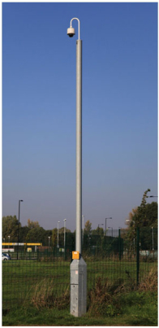
Take Home Exercise
Using the information presented in this session and knowledge of structures, design a camera pole for installation near the Interstate interchange with 12th Street North.
Notes:
Purpose of Slide: Introduce the exercise to be completed prior to the next class
Key Message: Civil work should support transportation needs in ITS
Time on Chart: 2 minutes
Suggested Comments: The exercise represents one of the civil design tasks that is typical of ITS deployments. While the task in the exercise is strictly a structure design, for the ITS deployment to be successful, transportation needs of the field device to be mounted on the structure must be accommodated. The exercise includes extensive background material that will support informed decisions about the mounting structure.
Transition:
Interactivity:
Additional Resources:

